Slide 1
Dana Diezemann
High Dynamic Range Imaging | HDR
A short summary
Image Sensors Europe London | 12. 3. 2020 | Revised 11. 6. 2020

Slide 2
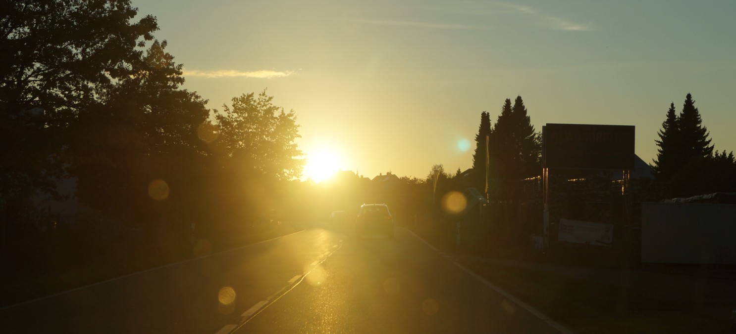
Notes:
Ich sehe nix mehr…

Slide 3
Polarized Pixels | Sony

Slide 4
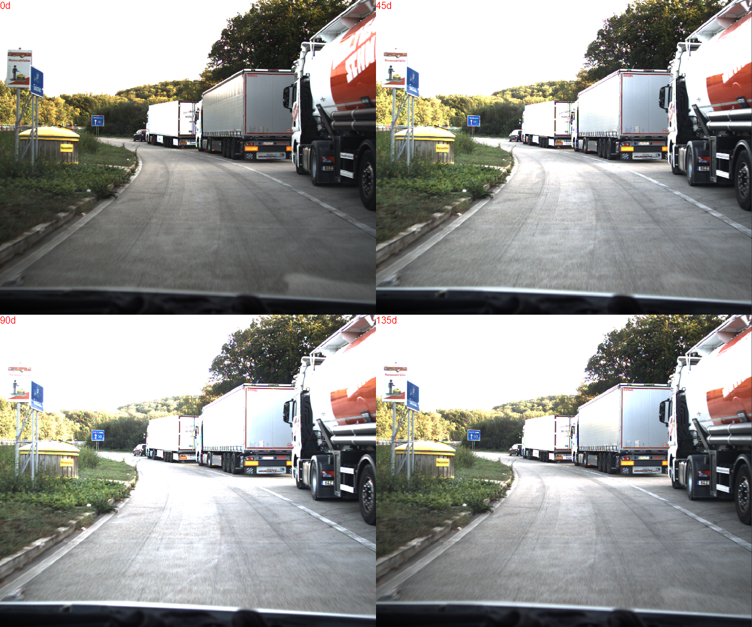

Slide 5
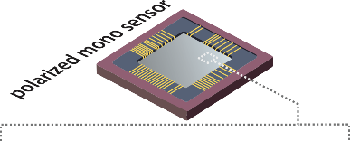
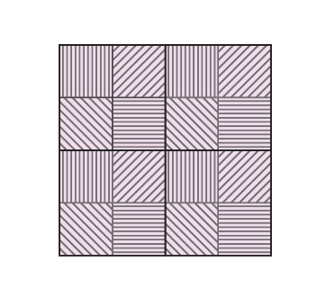
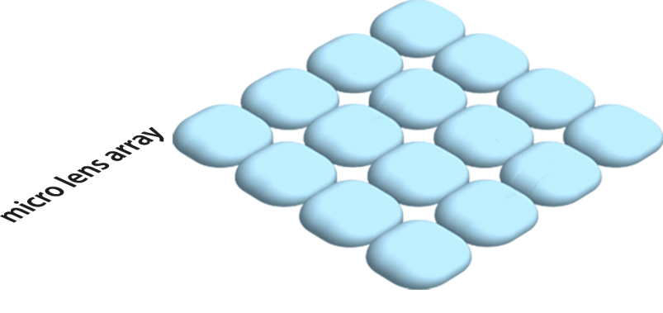
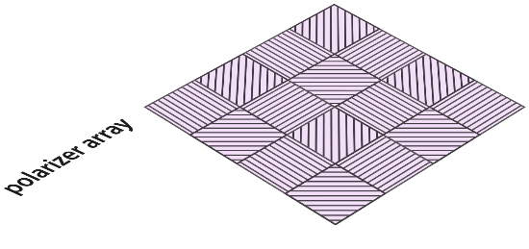
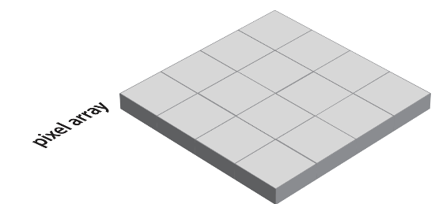
Polarized pixels | Sony
© LUCID Vision Labs

Slide 6
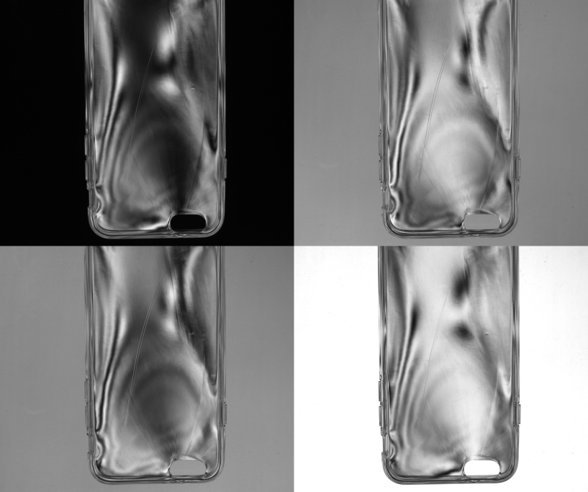
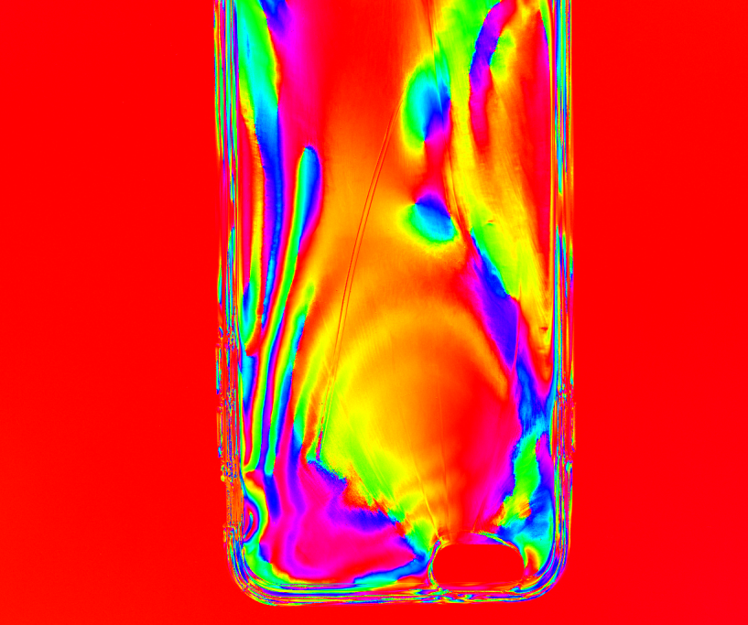
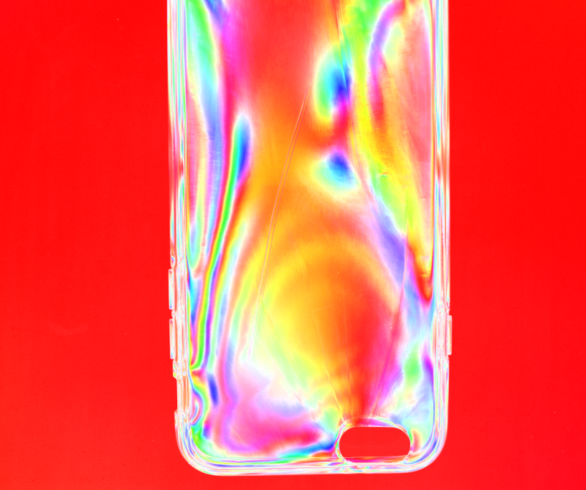
© LUCID Vision Labs

Slide 7
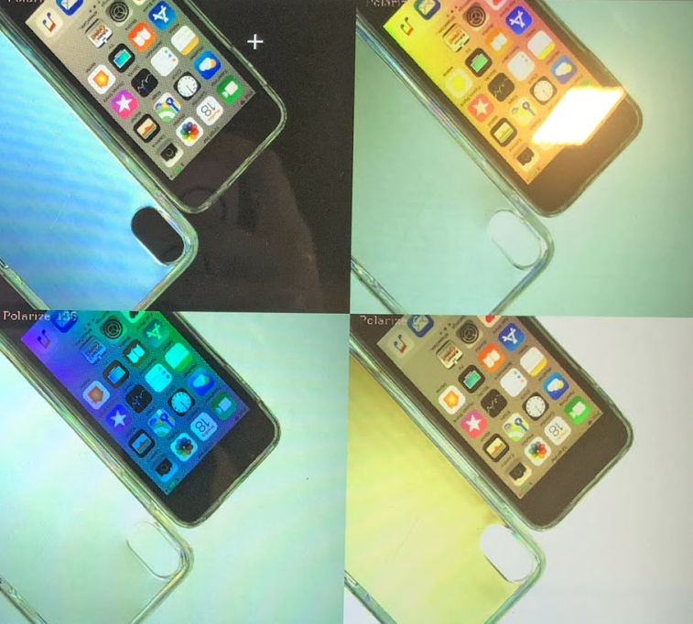
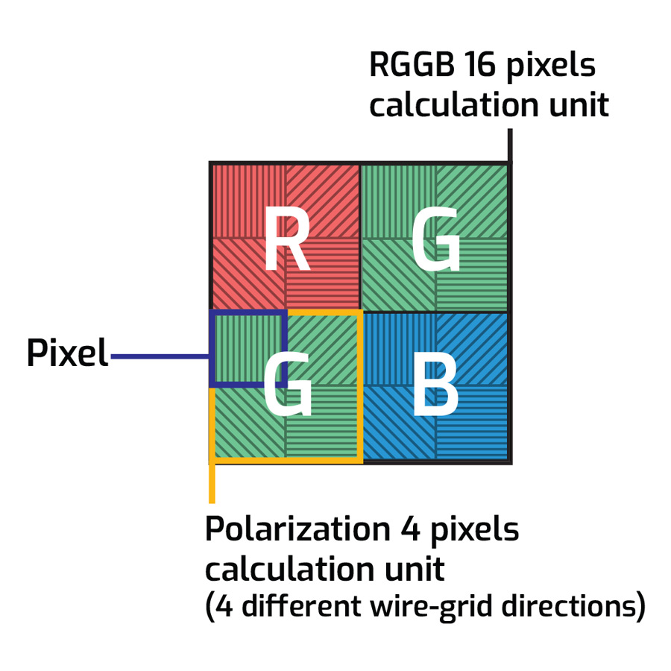
© LUCID Vision Labs

Slide 8
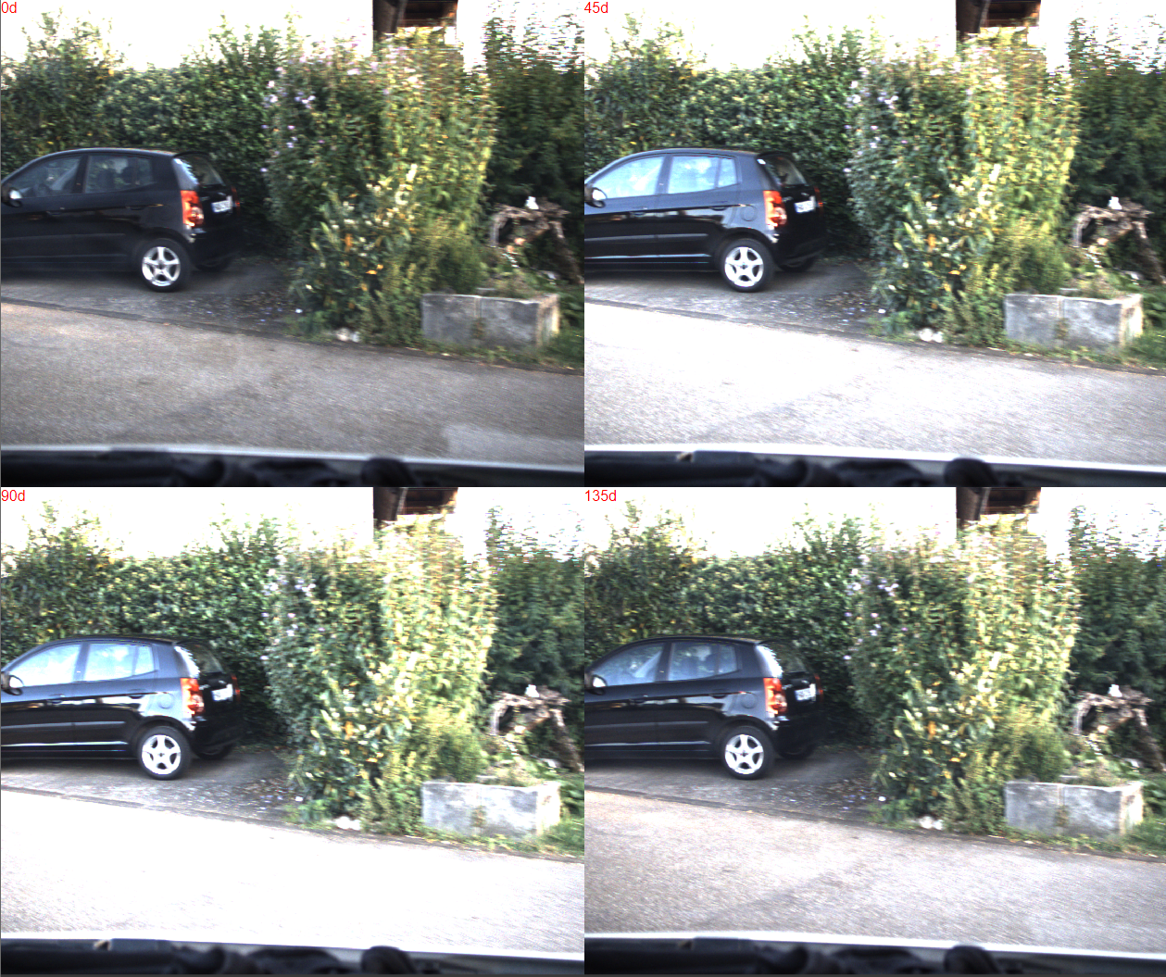
Polarized pixels | Sony
Pro:
4 different images in one capture.
Mono and color variants.
See more with reflections.
Con:
Not really more system dynamic.
Weak effect with stray light.

Slide 9
 |  | Polarization

Slide 10
Dynamic
Outdoor: ~ 160 dB

Slide 11
Fullwell Capacity
Dynamic Range = 20 x log
Noise
Examples
FW: 10.000 e- | Noise: 2e- | DR: 74 dB
FW: 100.000 e- | Noise: 1e- | DR: 100 dB
FW: 200.000 e- | Noise: 0.5e- | DR: 112 dB

Slide 12
HDR
A linear pixel has limitations in its dynamic range. Always.
Level
Time
Notes:
Saturation is…
Dynamic is…

Slide 13
Sequence |  | Polarization

Slide 14
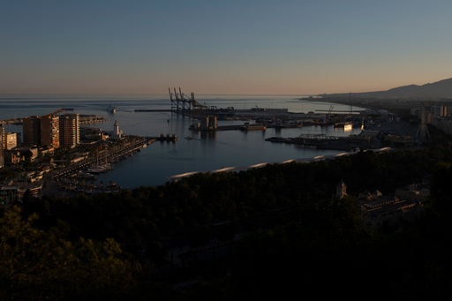
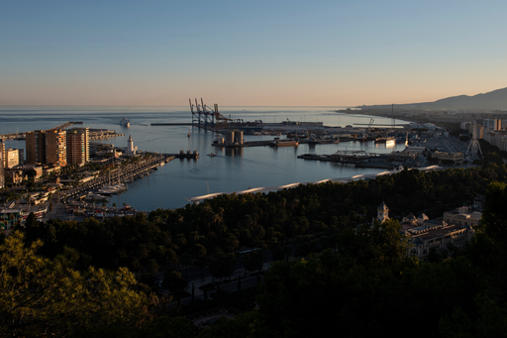
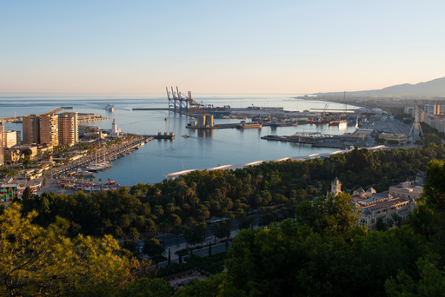
Sequencer
© Jörg Rieger Aurora HDR Software
Notes:
Mehrere Bilder einfach zusammenrechnen. Verschiedene Belichtungszeiten, Faktor 4 bis 16 üblicherweise

Slide 15
Sequencer
Sequencer Set of different settings (Exposure time, Gain), individual frame by frame
DOL (Digital Overlap) in Sony Starvis Rolling Shutter Imagers: 2 to 3 Images in a sequence
Result:
2 to 11 different images @ DSC DSLR: ISP @ PC: Software Aurora…
Con:
Slow in capture
Artefacts with moving objects or changed conditions
External processing
Different results due to algorithms.
Set A
Set B
Set C
Set A
Notes:
Das Grundprinzip von HDR. Einfach verschiedene Belichtungszeiten. Die in einem Verhältnis stehen. 1:4 oder 1:10.
Also bei 3 Bildern mit 1ms, 10ms und 100 ms. Belichtungssequenz. Nacheinander.
Mit 5 Bildern noch 0,1ms und 1 Sekunde dazu.
Zusammenbau dann am PC. Oder in der DSLR

Slide 16
Sequence |  | Polarization
Interleave

Slide 17
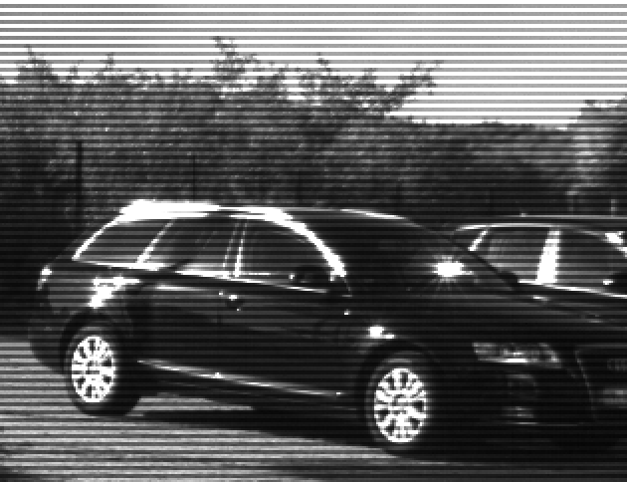
Single-frame multi-exposure
Example: Line wise
Short Exposure
1 3 5 7 9
2 4 6 8 10
Long Exposure

Slide 18
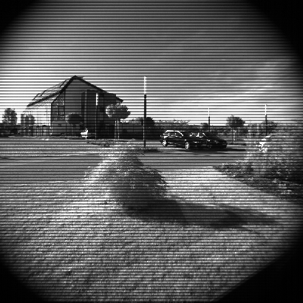
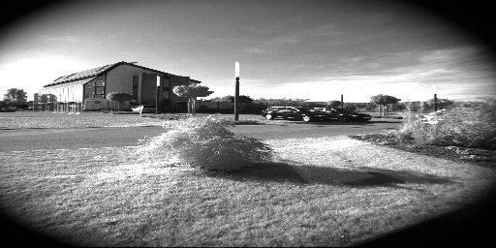
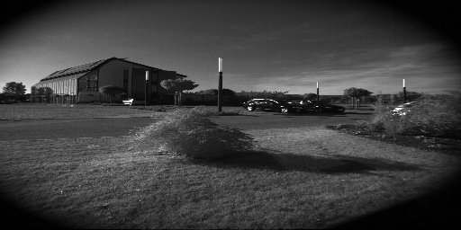
Single-frame multi-exposure

Slide 19
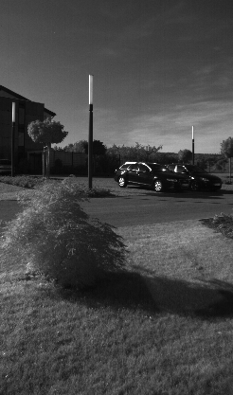
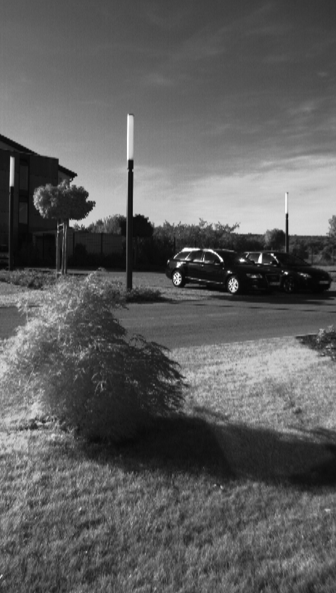
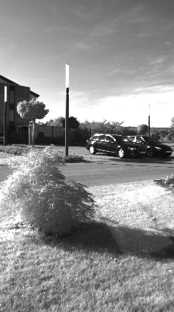
Single-frame multi-exposure

Slide 20
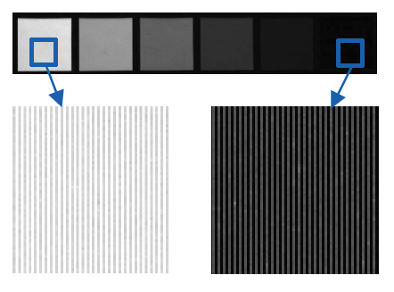
Single-frame multi-exposure
This is called Interleave HDR.
Line wise: Photonfocus | CMOSIS CMV | GPIXEL GMAX sensors.
Column wise: Teledyne e2v Snappy sensors.
The shorter exposure time starts later
by a longer pixel reset phase.
End by the charge transfer.
Pro: One image capture with 2 different images.
Con: Low resolution | weak HDR effect.
Different exposure start is difficult for moving objects.

Slide 21
Sequence |  | Polarization
Interleave
Dual Exposure

Slide 22
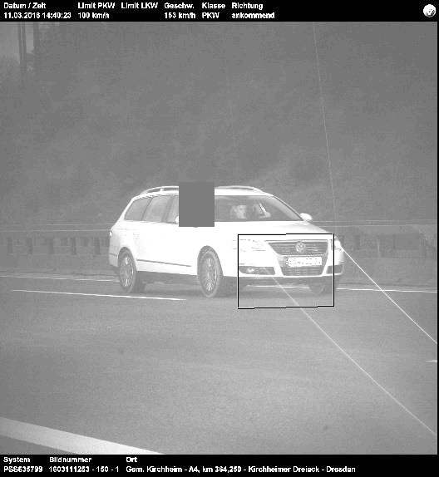
Dual exposure | triggering
Sony Pregius series | 3rd and 4th generation
Sensor is divided into two vertical regions
with different exposure timings and gain settings
ROI: Upper part
ROI: Lower part

Slide 23
Sequence |  | Polarization
Interleave
Dual Exposure
Piecewise linear

Slide 24
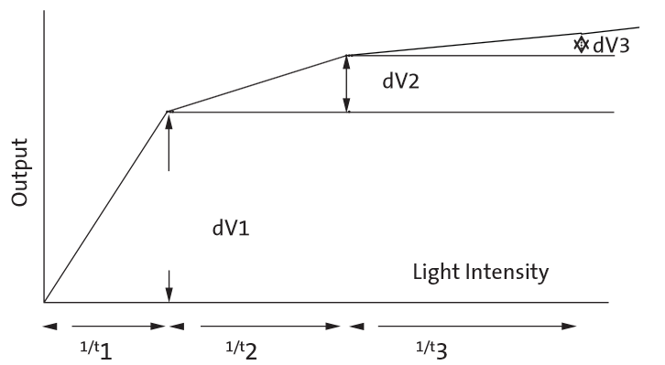
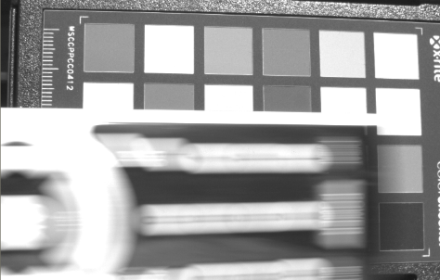
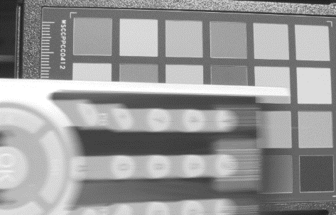
Multiple reset voltages & reset points
Called Kneepoint Mode or Piecewise Linear Pixel Response.
First example 2004: Micron MT9V022.
2 or 3 exposure phases.
Brighter pixels where reset to given level.
Then short exposure phase added
to saturate the pixels again.
And optional again.
Pro: One capture | One result.
Con: Moving bright objects | Color balance.

Slide 25
Sequence | Antiblooming | Polarization
Interleave
Dual Exposure
Piecewise linear

Slide 26
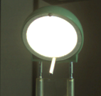
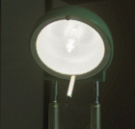
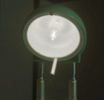
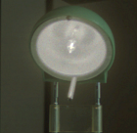
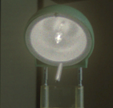
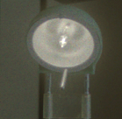
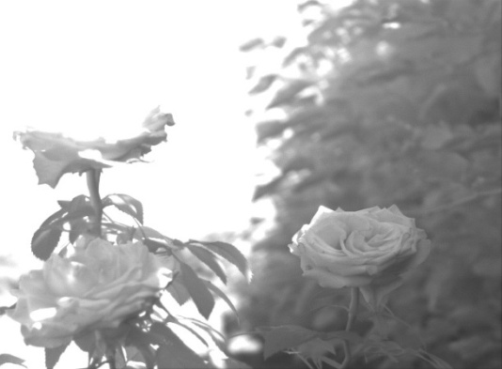
Playing with the Antiblooming Voltage…
Only the bright parts are “damped”

Slide 27
“Drill a hole and spill out…”
Level
Time
Notes:
Saturation is…
Dynamic is…

Slide 28
LinLog | Photonfocus
Different Anti Blooming Voltages
controls the offset of the “knee”.
Teledyne e2v: ev76c560 | ev76c570
Cons:
FPN around the kneepoint
Color Imaging
Not working with low light scenes

Slide 29
Sequence | Antiblooming | Polarization
Interleave | LinLog
Dual Exposure
Piecewise linear

Slide 30
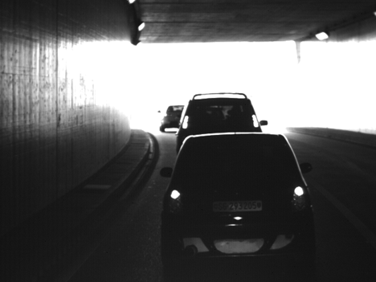
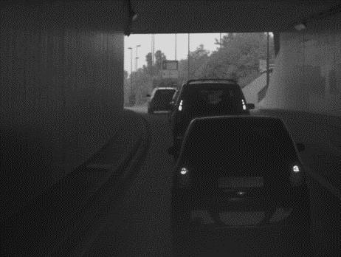
LinLog
Only the bright parts are “damped”

Slide 31
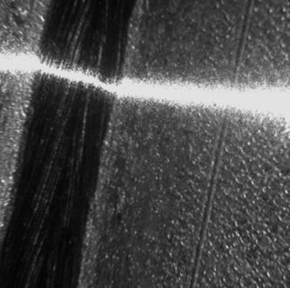
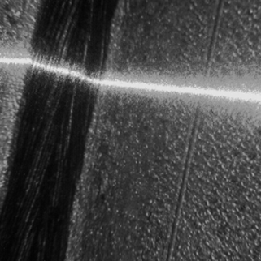
LinLog
Inspection of a Welding Seam
CMOS camera
with linear response curve (<60dB)
CMOS camera
with LinLog (120dB)

Slide 32
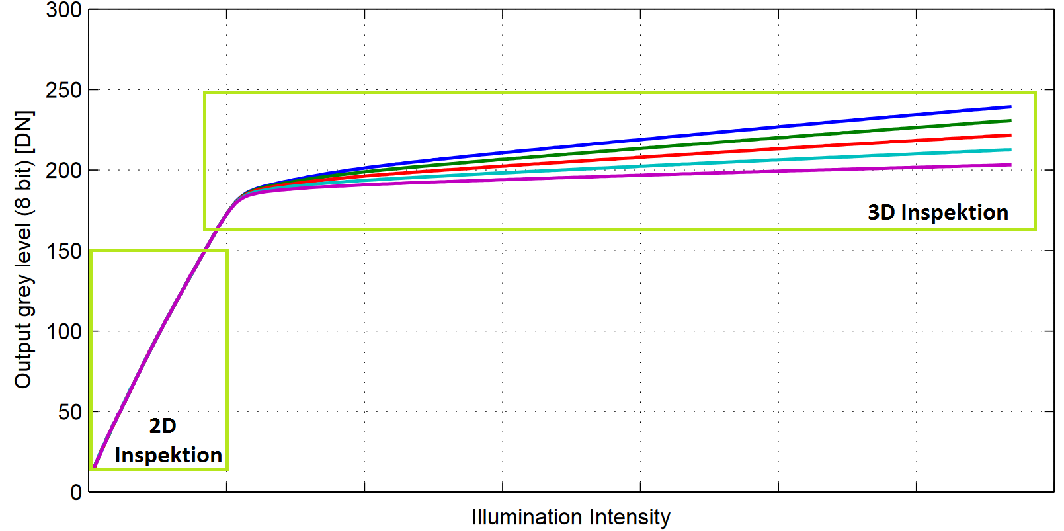
LinLog | Photonfocus & Log Mode | e2v
Different Anti Blooming Voltages
Called Kneepoints
Control offset and slope
LinLog (Photonfocus)
Offset and slope
LogMode (Teledyne e2v)
Offset
Con: FPN | Color Imaging | Motion artifacts with bright objects

Slide 33
Sequence | Antiblooming | Polarization
Interleave | LinLog
Dual Exposure | Real Log
Piecewise linear

Slide 34
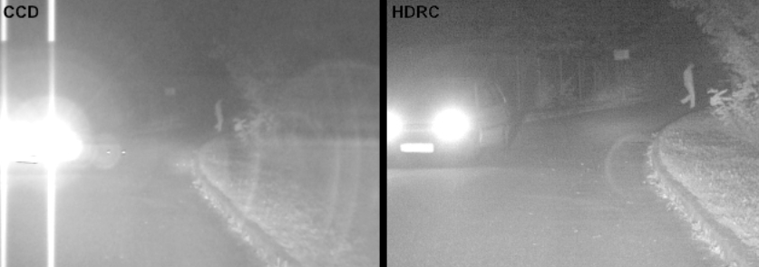
Full-logarithmic | IMS
HDRC Imager

Slide 35
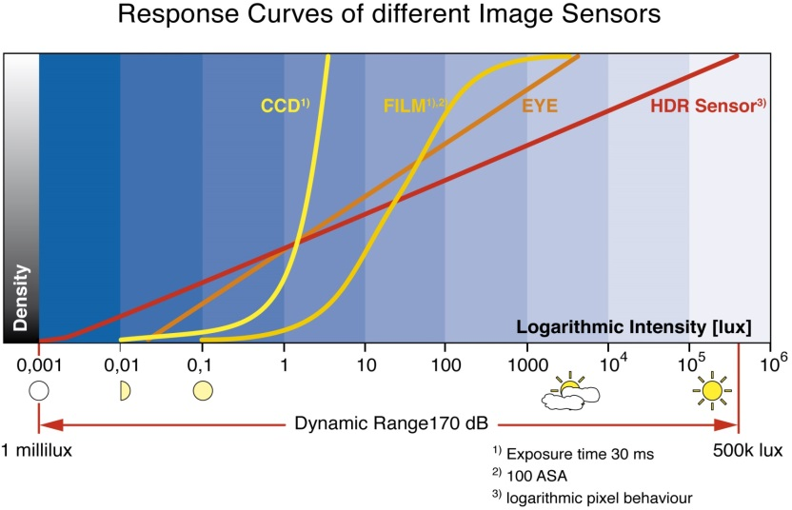
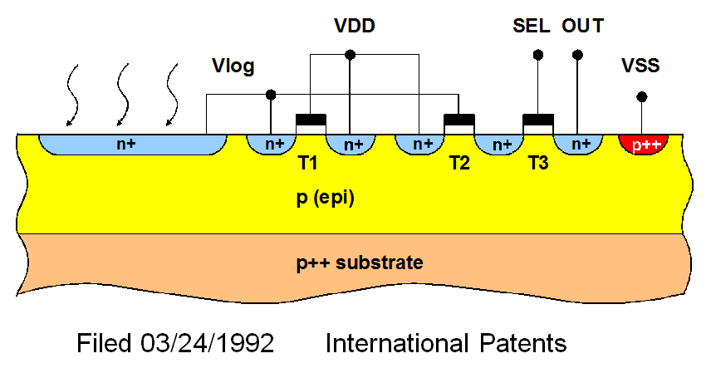
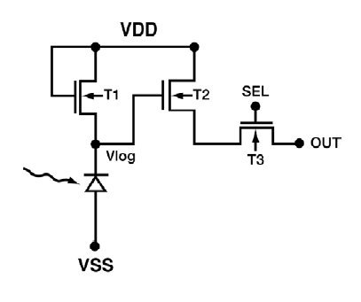
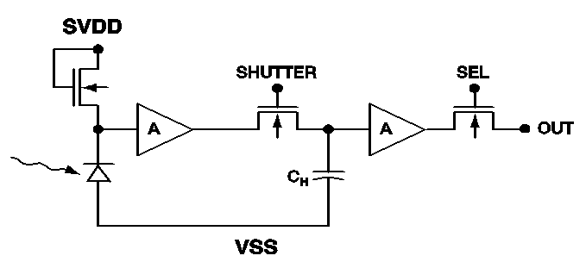
Full-logarithmic | IMS
HDRC (High Dynamic Range CMOS)
Pro: Real log Pixel
Con:
Complex DSNU & PRNU correction
Motion artifacts with bright objects

Slide 36
Sequence | Antiblooming | Polarization
Interleave | LinLog
Dual Exposure | Real Log
Piecewise linear | Solar Cell

Slide 37
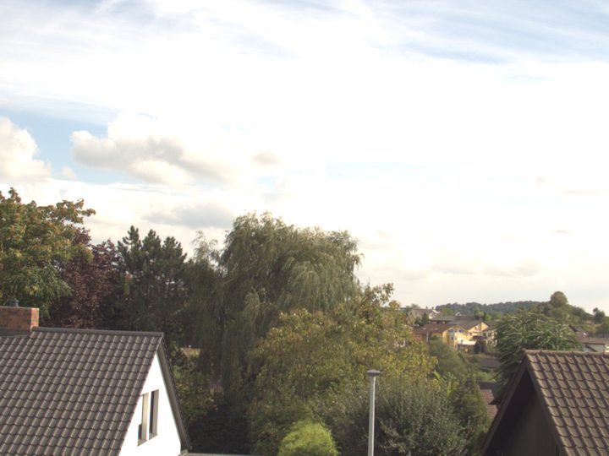
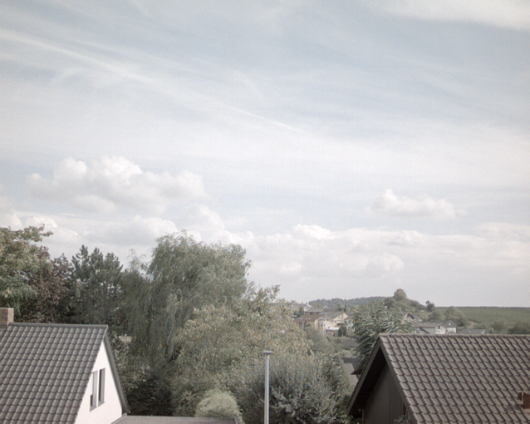
No integration | logarithmic | NIT
IMX 273 | 1.6 MP
NCS1701 | 1.3 MP
IMX 174
NSC1003

Slide 38
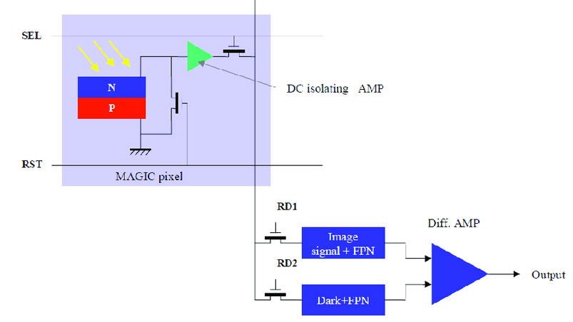
No integration logarithmic | NIT
WyDy | WDR – Wide Dynamic Range
Pro:
Solar cell pixel | actual light value
no integration | global readout
real log pixel
Con:
FPN
Image lag
black level drift (dark current)
analog output | timing like CCD

Slide 39
Conclusion
It depends – There is no winner. But a lot of inspiration for a modern pixel design!
 | HDR Effect | Image Prozessing | Moving objects | Camera implementation | Image quality
Polarized pixels | -- | + | ++ | + | +
Sequencer | ++ | -- | -- | -- | ++
Interleave Exposure | - | -- | - | - | +
LinLog | + | + | + | + | --
Kneepoint mode | + | + | + | + | --
Full-logarithmic Log | ++ | -- | + | - | +
No integration Log | ++ | - | + | -- | +
System | -- | - | + | ++

Slide 40
Sequence | Antiblooming | Polarization
Interleave | LinLog | Dual Conversion Gain
Dual Exposure | Real Log
Piecewise linear | Solar Cell

Slide 41
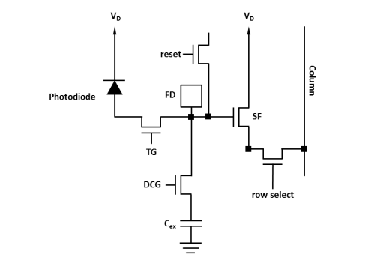
Dual conversion gain
Convert photons twice and different into electrons!
LCG – Low Conversion Gain
This is the normal mode.
White is at 90% of pixel saturation.
For bright parts in the image.
HCG – High Conversion Gain
Advantage in SNR at low illuminance levels.
For dark parts in the image.
Factor 2 to 7 between LCG and HCG.
Combine on chip or with ISP!
LCG
HCG

Slide 42
Sequence | Antiblooming | Polarization
Interleave | LinLog | Dual Conversion Gain
Dual Exposure | Real Log | Dual Storage Node
Piecewise linear | Solar Cell

Slide 43
Pyxalis | STM: Dual storage node
One Global Shutter Pixel with 2 storage nodes
First: Short Exposure Time
Second: Long Exposure Time

Slide 44
Sequence | Antiblooming | Polarization | ???
Interleave | LinLog | Dual Conversion Gain
Dual Exposure | Real Log | Dual Storage Node
Piecewise linear | Solar Cell

Slide 45
Split and Dual in combination
Split Photodiode
Large – LPD | Small – SPD
Dual conversion gain
High – HCG
Low- LCG
Dual Conversion Gain
x1
p to e-
x4
101100101001
001011100100

Slide 46
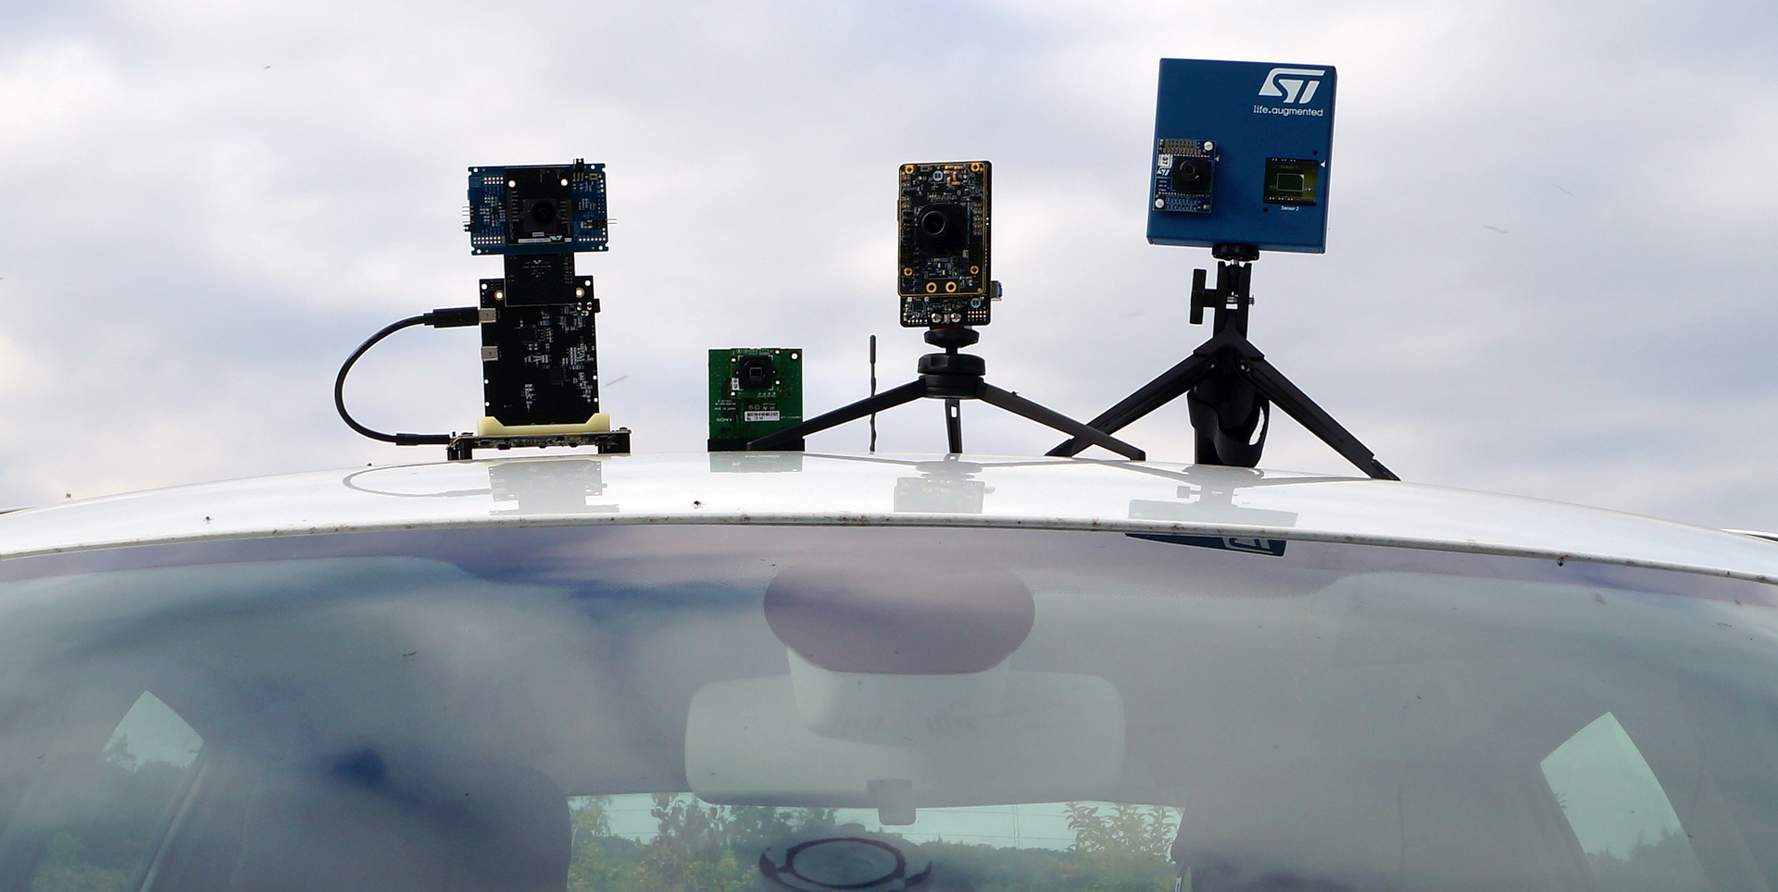

Slide 49
Sequence | Antiblooming | Polarization | Sony IMX390
Interleave | LinLog | Dual Conversion Gain
Dual Exposure | Real Log | Dual Storage Node
Piecewise linear | Solar Cell

Slide 50
Sony Semiconductor IMX390

Slide 51
Sony Semiconductor IMX 390
One capture – three interleave readouts
Image
Output
Level
Small PD
in LCG
Small PD
Large PD
in HCG
Luminance
Notes:
Übergänge sind kritisch

Slide 52
Sony Semiconductor IMX 390
Composing…
Image
Output
Level
LPD
SNR drop
Blending
x Gain
SPD
x Gain
Blending
Small PD
in LCG
Small PD
Large PD
in HCG
Luminance
Notes:
Übergänge sind kritisch

Slide 53
Sony Semiconductor
Sony | IMX390CQV-W
Sensor | 2.3 MP | 1920 x 1200 | 50 fps | Color | RS
Pixelarray | Dual PD | 1:31? | 3.0µm | 1/2.7“ | 21° CRA
Exposure / Images | 1 / 3
Conversion gain | Dual for Small Pixel | 1:3.6
HDR | 110 / 120 dB | On Board | 12 - 24 Bit | RAW | Combined | Compressed
Anti flicker | Yes
Features | LUT | BLC | DNR | Shading | DPC
Output | MIPI CSI-2 | 4-lane

Slide 54
Sony Semiconductor
IMX390
2 MP class
3 readouts
IMX490
5.4 MP | 3k x 2k class | 3µm | 10.3mm diag
4 readouts (Dual Pixel, twice dual conversion gain)
Further family extension planned 2020 / 2021
with a 3 MP and a 2 MP sensor

Slide 55
Sequence | Antiblooming | Polarization | Sony IMX390
Interleave | LinLog | Dual Conversion Gain | On Semi AR0233
Dual Exposure | Real Log | Dual Storage Node
Piecewise linear | Solar Cell

Slide 56
On Semiconductor AR0233

Slide 57
On Semiconductor
Single PD with additional local overflow „Area“
Dual CG | 4 readouts to combine

Slide 58
On Semiconductor
On Semiconductor | AR0233
Sensor | 2.65 MP | 2064 x 1288 | 45 fps | Color | RS
Pixelarray | Single PD | 3.0µm | 1/2.5“ | 17° CRA
Exposures / Images | 2 / 4
Conversion gain | Dual on PD | +Overflow
HDR | 140 dB | On Board Processing | 24 Bit RAW | …
Anti flicker | Yes
Features | …
Output | MIPI CSI-2 | 4-lane

Slide 59
On Semiconductor

Slide 60
On Semiconductor
AR0233
2.6 MP | Single PD | Dual storage | Dual CG on PD
AR0820
8 MP | 4k x 2k | 2.1µm | 1/2” | Dual PD | Dual CG

Slide 61
Sequence | Antiblooming | Polarization | Sony IMX390
Interleave | LinLog | Dual Conversion Gain | On Semi AR0233
Dual Exposure | Real Log | Dual Storage Node | OVT OX02A10
Piecewise linear | Solar Cell

Slide 62
Omnivision OX02A10

Slide 63
Omnivision
Exposure
Readout
Short Exposure Time
Small PD
Long Exposure Time
Large PD
Large PD
Small PD
Large PD with HCG
Large PD with LCG
x1
x2.5
p to e-
101100101001
001011100100

Slide 64
Omnivision
OmniVision | OX02A10
Sensor | 1.7 MP | 1824 x 940 | 60 fps | Color | RS
Pixelarray | Dual PD | 4.2µm | 1/2.1“ | 19° CRA
Exposure / Images | 2 / 3
Conversion gain | Dual at LPD | 1:2.5
HDR | 110 – 120 dB | On Board | 20 Bit linear comb. | RAW | YUV
Anti flicker | Yes
Features | LENC, DPC, DNR, ToneMap, AWB, AEC, AGC, BLC, LUT
Output | 12 Bit Parallel | MIPI CSI-2 with 4-lanes

Slide 65
Omnivision
OX02A10
1.7 MP | Dual PD | Dual Gain on one PD
OX03A10
2.46 MP | Single PD | Dual Gain | 120dB | 50 fps
OX01D10
1.2 MP | Dual PD | Dual Gain on one PD
OX01B40
1.3 MP | Dual PD | Dual Gain on one PD
+ 120 dB with stacked ISP

Slide 66
Sequence | Antiblooming | Polarization | Sony IMX390
Interleave | LinLog | Dual Conversion Gain | On Semi AR0233
Dual Exposure | Real Log | Dual Storage Node | OVT OX02A10
Piecewise linear | Solar Cell |  | STM VC 6768

Slide 67
ST Microelectronics VG6768

Slide 68
ST Microelectronics
Traditional 3 exposure times in a sequence is not bad
Issues with LED light sources
Issues with motion

Slide 69
ST Microelectronics
Chopping the exposure is the right direction.
Catch LED Illumination correct.
But with moving objects it gets much more worse.

Slide 70
ST Microelectronics
Interleave parallel in 2 photodiodes is faster

Slide 71
ST Microelectronics
ST Microelectronics | VG6768
Sensor | 2.5 MP | 1928 x 1288 | 60 fps | Color | RS
Pixelarray | Dual PD | 1:4 | 3.2µm | 1/2.1“ | 15° CRA
Exposure / Images | 1 / 3
Conversion gain | Dual | 1:3
HDR | 145 dB | 14 + 11 + 11 Bit | Merge
Anti flicker | Yes
Features | BLC | DPC | DNR | LUT
Output | MIPI CSI-2 | 4-lane

Slide 72
ST Microelectronics

Slide 73
Summary
 | Sony IMX390 | ST Micro VG6768 | OVT OX02A10 | On Semi AR0233
PD per Pixel | Dual | Dual | Dual | Single
Exposure / Images | 1 | 1 | 2 (sim) | 2 (seq)
Conversion gain / readout | Dual for SPD | Dual for LPD | Dual for LPD | Dual for PD
Resulting images | 3 | 3 | 3 | 4

Slide 74
Sequence | Antiblooming | Polarization | Sony IMX390
Interleave | LinLog | Dual Conversion Gain | On Semi AR0233
Dual Exposure | Real Log | Dual Storage Node | OVT OX02A10
Piecewise linear | Solar Cell | SPAD / QIS | STM VC 6768

Slide 75
SPAD / QIS
Say „hello“ to a single photon!
Single Photon Avalance Diode in an 2D-Array
Quanta Image Sensor
100 – 150 ps timing resolution
Digital counting
130 - 150 dB DR
Promising? Trend?

Slide 76
Summary
Forget linear cameras with single conventional pixel
The classic methods shows the direction
The new pixel designs are the right way
All 4 modern HDR sensors are doing a great job
The HDR image quality is near perfect
The overall image quality is better with an external ISP
The Implementation is easy (SW / HW)
And take care of lenses and IR-cut filter

Slide 77
High Dynamic Range Imaging
A short summary
Dana Diezemann
Senior Strategical Product Manager
ddiezemann@isravision.com
+49 6151 948 278 | +49 172 2980 278
isravision.com | photonfocus.com

